Slide 1



Prediction of Online Shopper’s Purchasing Intention Using Binary Logistic Regression, Decision Tree, and Random Forest

Slide 2

Outline
01
Introduction
02
Literature Review
03
Method
04
Results & Discussion
05
Conclusion & Suggestion

Slide 3

Introduction

Slide 4
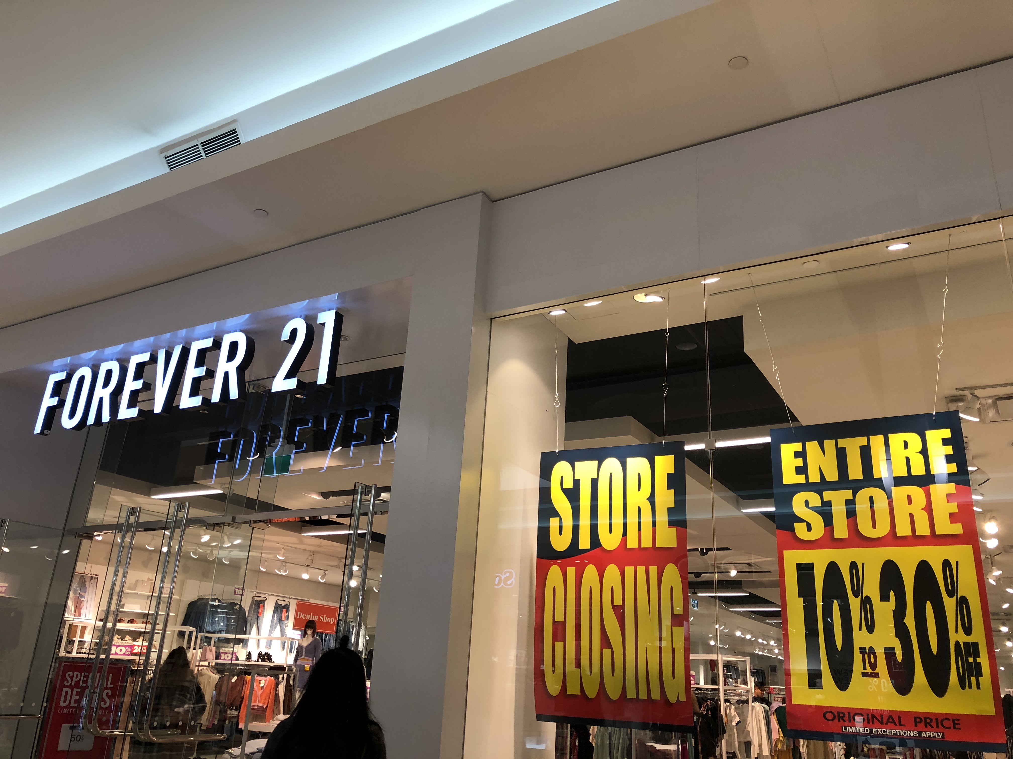

Online Shopping
Online shopping is becoming a trend in recent year. Burdened by expensive store leases, unprofitable markets and continuing disruption from online shopping, Forever 21 will close 200 stores.
Compared to the physical stores, customers prefer do online shopping, mainly because people find it convenient and easy to bargain shop from the comfort of their home or office

Slide 5




Slide 6
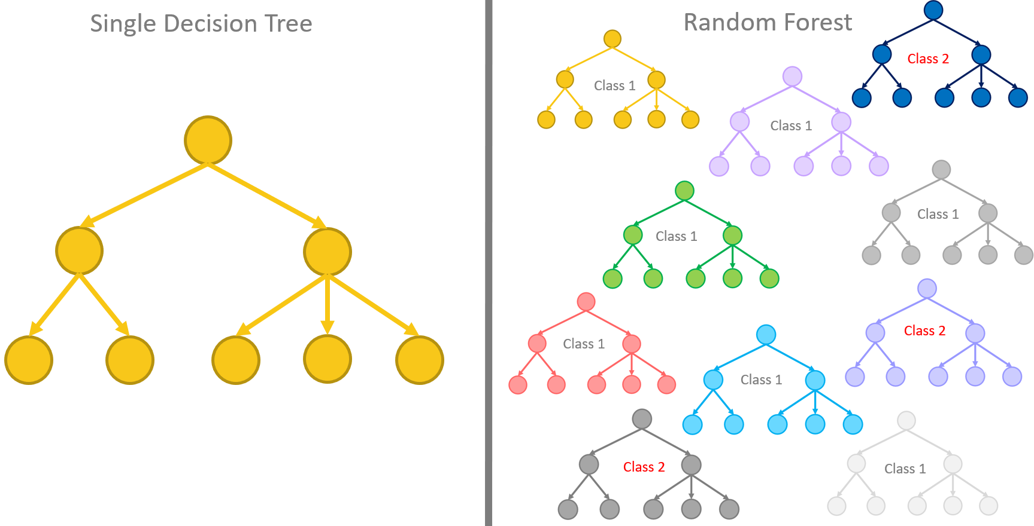
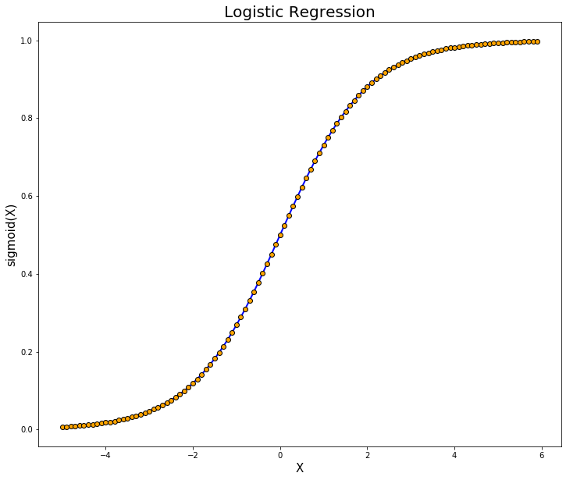
Introduction

Slide 7
LITERATURE REVIEW

Slide 8
DATA CLEANING
MISSING VALUE

Slide 9
Future Selection
Filters
Wrappers
Embedded Selectors

Slide 10
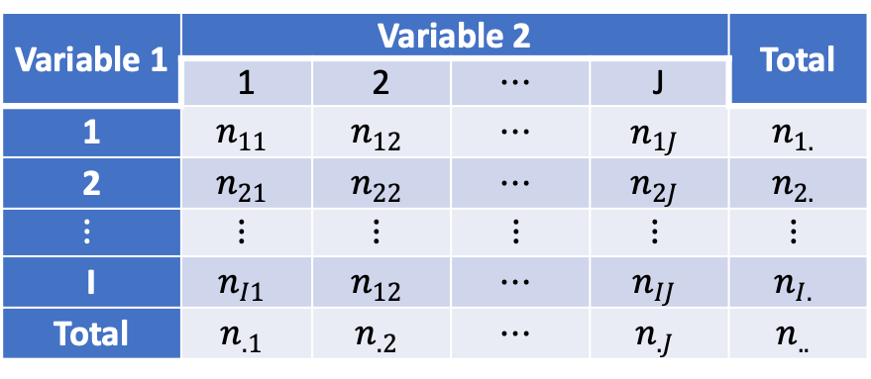
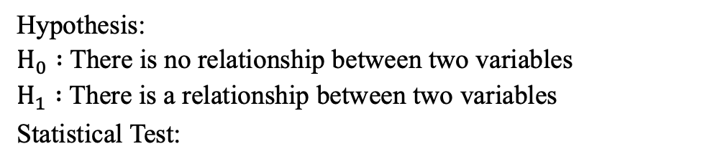
Chi-Squared Test of Independence
Variable 1 | Variable 2 |  |  |  | Total
 | 1 | 2 | $$⋯$$ | J
1 | $$n_{11}$$ | $$n_{12}$$ | $$⋯$$ | $$n_{1J}$$ | $$n_{1.}$$
2 | $$n_{21}$$ | $$n_{22}$$ | $$⋯$$ | $$n_{2J}$$ | $$n_{2.}$$
$$⋮$$ | $$⋮$$ | $$⋮$$ | $$⋮$$ | $$⋮$$ | $$⋮$$
I | $$n_{I1}$$ | $$n_{12}$$ | $$⋯$$ | $$n_{IJ}$$ | $$n_{I.}$$
Total | $$n_{.1}$$ | $$n_{.2}$$ | $$⋯$$ | $$n_{.J}$$ | $$n_{..}$$
Hypothesis:
$H_{0} :$ There is no relationship between two variables
$H_{1} :$ There is a relationship between two variables
Statistical Test:

Slide 11
Multicollinearity Test

Slide 12
CLASSIFICATION
METHOD
BINARY LOGISTIC REGRESSION
DECISION TREE
RANDOM FOREST
Random forest is an ensemble learner, a method that generates many classifiers and aggregates their results. RF will create multiple classification and regression (CART) trees, each trained on bootstrap sample of the original training data and searches across a randomly selected subset of input variables to determine the split.
Binary logistic regression is a data analysis method used to find the relationship between the binary or dichotomous response variable with polycotomous predictor variable (Hosmer, 2013). The response variable follows the Bernoulli distribution for every single observation.
In principle, decision trees are used to predict the membership of objects to different categories (classes), taking into account the values that correspond to their attributes (predictor variables) (Gorunescu, 2011).

Slide 13
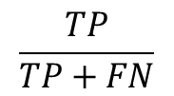
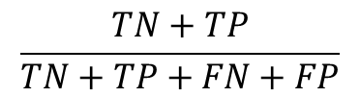
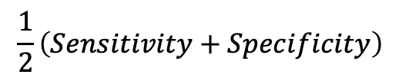
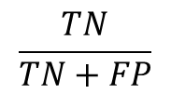
PERFORMANCE EVALUATION OF CLASSIFIERS
ACCURACY
$$\frac{TN+TP}{TN+TP+FN+FP}$$
1
2
SENSITIVITY
AUC
4
$$\frac{TP}{TP+FN}$$
$$\frac{1}{2}\left(Sensitivity+Specificity\right)$$
3
SPECIFICITY
$$\frac{TN}{TN+FP}$$

Slide 14
Methodology

Slide 15
Data Source
Data Source
https://archive.ics.uci.edu/ml/datasets/Online+ShoppersP-urchasing+Intention+Dataset
Variable
The data explain about the online shopper’s intention. There are 12330 observation and 18 variables.

Slide 16
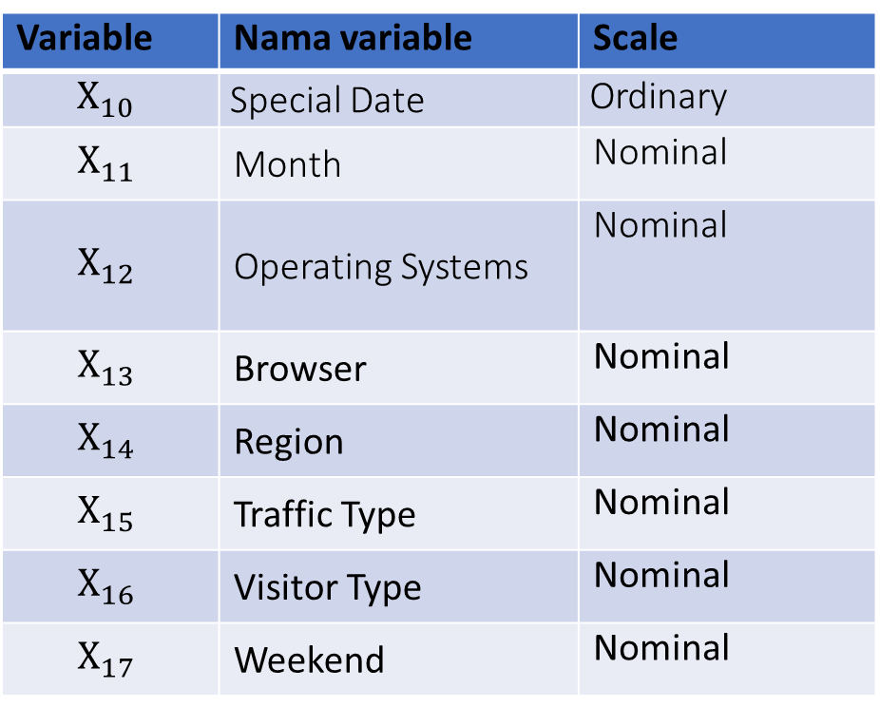
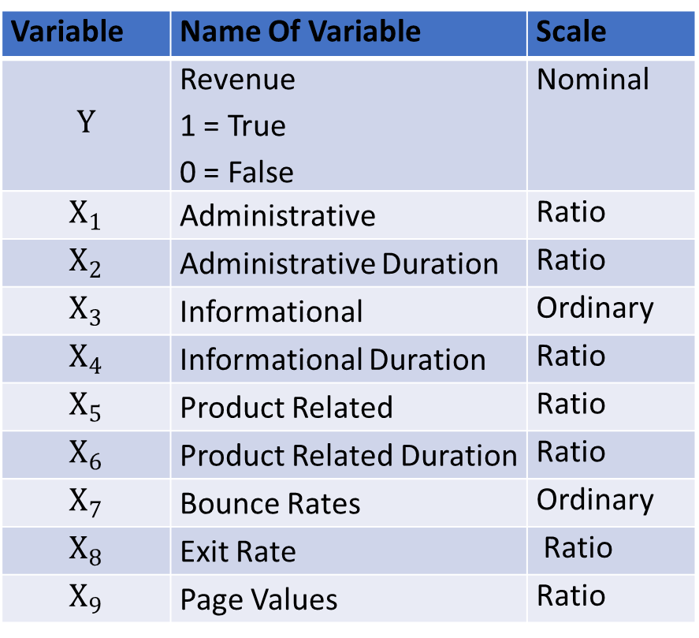
Variable
Variable | Name Of Variable | Scale
$$Y$$ | Revenue 1 = True 0 = False | Nominal
$$X_{1}$$ | Administrative | Ratio
$$X_{2}$$ | Administrative Duration | Ratio
$$X_{3}$$ | Informational | Ordinary
$$X_{4}$$ | Informational Duration | Ratio
$$X_{5}$$ | Product Related | Ratio
$$X_{6}$$ | Product Related Duration | Ratio
$$X_{7}$$ | Bounce Rates | Ordinary
$$X_{8}$$ | Exit Rate | Ratio
$$X_{9}$$ | Page Values | Ratio
Variable | Nama variable | Scale
$$X_{10}$$ | Special Date | Ordinary
$$X_{11}$$ | Month | Nominal
$$X_{12}$$ | Operating Systems | Nominal
$$X_{13}$$ | Browser | Nominal
$$X_{14}$$ | Region | Nominal
$$X_{15}$$ | Traffic Type | Nominal
$$X_{16}$$ | Visitor Type | Nominal
$$X_{17}$$ | Weekend | Nominal

Slide 17
Step Analysis
Pre-processing
Feature Selection & Multicollinearity Test
EDA
Decision Tree Model
Compare The Accuracy
Random Forest Model
SMOTE & Spilt Data
Binary Regression Logistic Model

Slide 18
RESULTS & DISCUSSION

Slide 19
Pre-processing
No missing value
Imbalance
Oversampling (SMOTE)

Slide 20
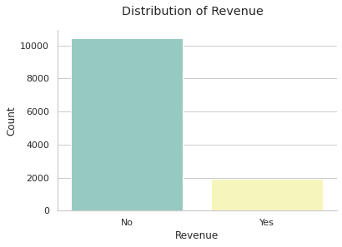
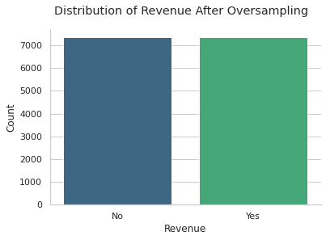
Pre-processing

Slide 21
Feature Selection
Variable | Chi-square Score | Result
Administrative | 1133.97 | Significant
Administrative Duration | 41754.84 | Significant
Informational | 357.98 | Significant
Informational Duration | 35059.78 | Significant
Product Related | 19317.29 | Significant
ProductRelated Duration | 877404.34 | Significant
Bounce Rates | 29.65 | Significant
Exit Rate | 28.99 | Significant
PageValues | 175126.81 | Significant
Variable | Chi-square Score | Result
Special Date | 53.80 | Significant
Month | 86.16 | Significant
Operating Systems | 1.04 | Significant
Browser | 8.87 | Significant
Region | 3.04 | Not Significant
Traffic Type | 1.28 | Significant
Visitor Type | 37.55 | Significant
Weekend | 8.12 | Significant

Slide 22
Multicollinearity Test
Variable | Chi-square Score | Result
Administrative | 2.832 | Significant
Administrative Duration | 2.044 | Significant
Informational | 2.120 | Significant
Informational Duration | 1.779 | Significant
Product Related | 6.667 | Not Significant
Product Related Duration | 6.015 | Not Significant
Bounce Rates | 7.345 | Not Significant
Exit Rate | 11.721 | Not Significant
Variable | Chi-square Score | Result
PageValues | 1.142 | Significant
Special Date | 1.132 | Significant
Month | 4.579 | Significant
Operating Systems | 5.664 | Not Significant
Browser | 2.940 | Significant
Traffic Type | 2.120 | Significant
Visitor Type | 6.155 | Not Significant
Weekend | 1.287 | Significant
Special Date | 1.132 | Significant

Slide 23
Multicollinearity Test
Variable | VIF | Result
Administrative | 2.574 | Significant
Administrative Duration | 1.968 | Significant
Informational | 2.105 | Significant
Informational Duration | 1.761 | Significant
ProductRelated Duration | 1.905 | Significant
Bounce Rates | 1.330 | Significant
PageValues | 1.126 | Significant
Special Date | 1.128 | Significant
Month | 4.255 | Significant
Browser | 2.551 | Significant
Traffic Type | 1.999 | Significant
Visitor Type | 4.777 | Significant
Weekend | 1.278 | Significant

Slide 24
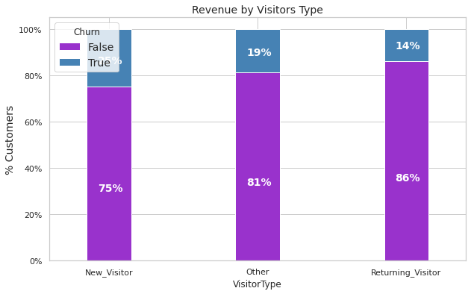
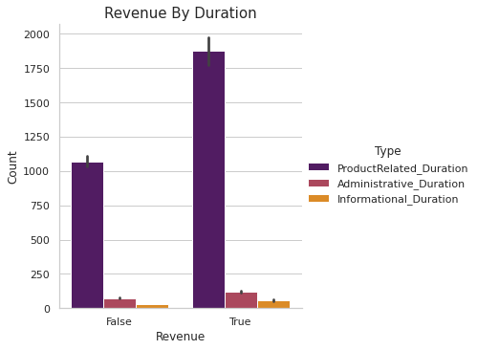
Visualization Data

Slide 25
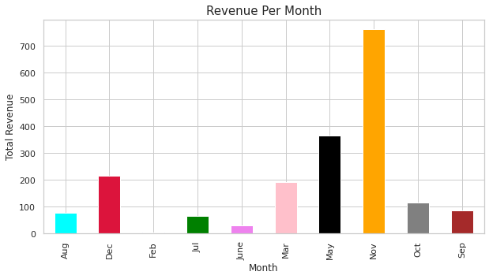
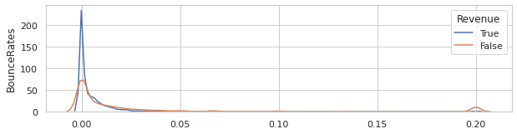
Visualization Data

Slide 26
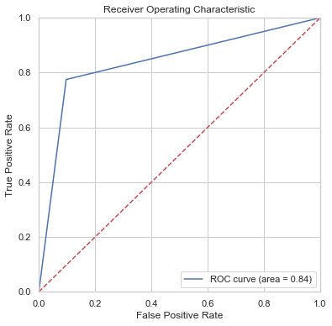
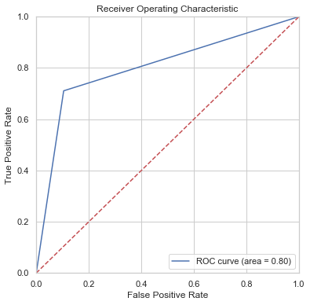
Binary Logistic Regression
5-Fold
TRAINING
TESTING
Accuracy | Sensitivity | Specificity | AUC
83,87% | 77,47% | 90,28% | 83,87%
Accuracy | Sensitivity | Specificity | AUC
86,46% | 71,06% | 89,57% | 80,31%

Slide 27


Binary Logistic Regression
TRAINING
10-Fold
TESTING
Accuracy | Sensitivity | Specificity | AUC
83,91% | 77,47% | 90,35% | 83,91%
Accuracy | Sensitivity | Specificity | AUC
86,56% | 71,38% | 89,63% | 80,51%

Slide 28
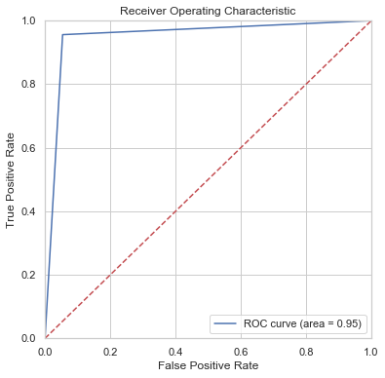

Decision Tree
TRAINING
5-Fold
TESTING
Accuracy | Sensitivity | Specificity | AUC
95,09% | 95,58% | 94,61% | 95,09%
Accuracy | Sensitivity | Specificity | AUC
87,59% | 69,94% | 91,16% | 80,55%

Slide 29
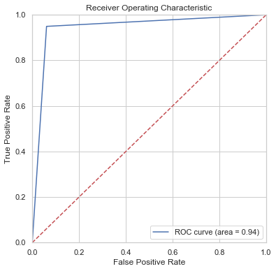
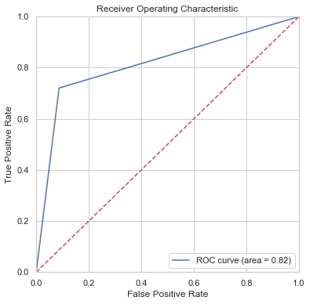
Decision Tree
10-Fold
TRAINING
TESTING
Accuracy | Sensitivity | Specificity | AUC
94,40% | 94,91% | 93,90% | 94,40%
Accuracy | Sensitivity | Specificity | AUC
88,08% | 72,03% | 91,32% | 81,67%

Slide 30
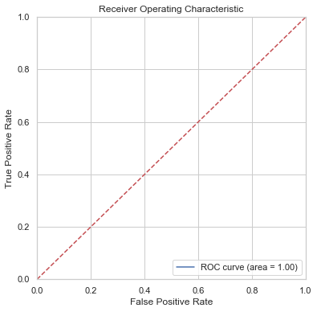
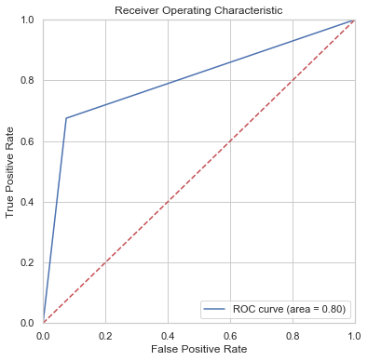
Random Forest
TRAINING
5-Fold
TESTING
Accuracy | Sensitivity | Specificity | AUC
100% | 100% | 100% | 100%
Accuracy | Sensitivity | Specificity | AUC
88,35% | 67,52% | 92,56% | 80,04%

Slide 31
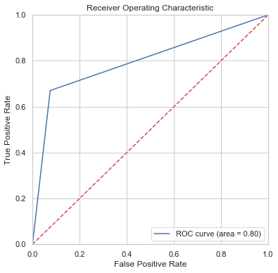
Random Forest
10-Fold
TRAINING
TESTING
Accuracy | Sensitivity | Specificity | AUC
100% | 100% | 100% | 100%
Accuracy | Sensitivity | Specificity | AUC
88,21% | 67,04% | 92,49% | 79,77%

Slide 32
Determine Best Model
Method | Cross Validation | Accuracy | AUC
Binary Logistic Regression | 5-fold | 86,46% | 80,31%
 | 10-fold | 86,56% | 80,51%
Decision Tree | 5-fold | 87,59% | 80,55%
 | 10-fold | 88,08% | 81,67%
Random Forest | 5-fold | 88,35% | 80,04%
 | 10-fold | 88,21% | 79,77%

Slide 33
Conclusion & Suggestion

Slide 34
Conclusion
The biggest probability of gaining revenue are new visitor, visitors who has low bounce rate, month sales in November and May, visitor who spent more times in product related.
The best model for predict online shopper’s purchasing intention is random forest using 5-fold cross-validation with 88,21% accuracy

Slide 35
Suggestion
Suggestions obtained from this research for further research if you want to do a classification analysis for predict online shopper’s purchasing intention with a better accuracy value, then can do trials with other classification methods besides the binary logistic regression, decision tree, and random forest that have been analyzed at this research.

Slide 36
Thank You

